Slide 1
Interpretable Graph Neural Networks for Molecular Property Prediction and Conditional VAEs for Property-Driven Molecule Generation
Ramesh Raj S
Guide: Prof. Tarak Patra

Slide 2
Introduction
Problem 1: Property Prediction
Predict free energy from SMILES.
Used Graph Neural Networks (GNNs) for leveraging molecular graph topology.
Identified key atoms and bonds influencing predictions.
Problem 2: Inverse Design
Predict valid SMILES given a target free energy.
Developed a Conditional Variational Autoencoder (CVAE) for inverse mapping.

Slide 3
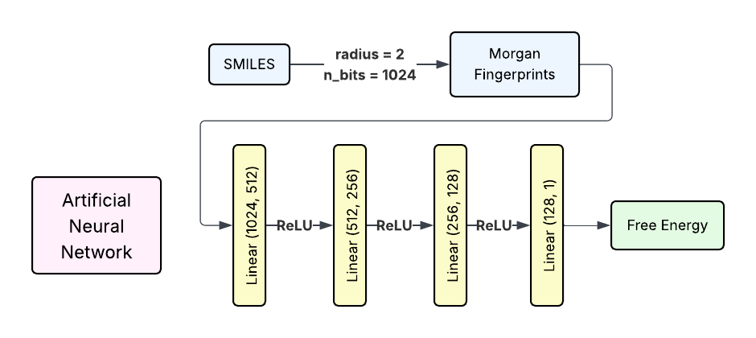
Morgan Fingerprints – ANN

Slide 4
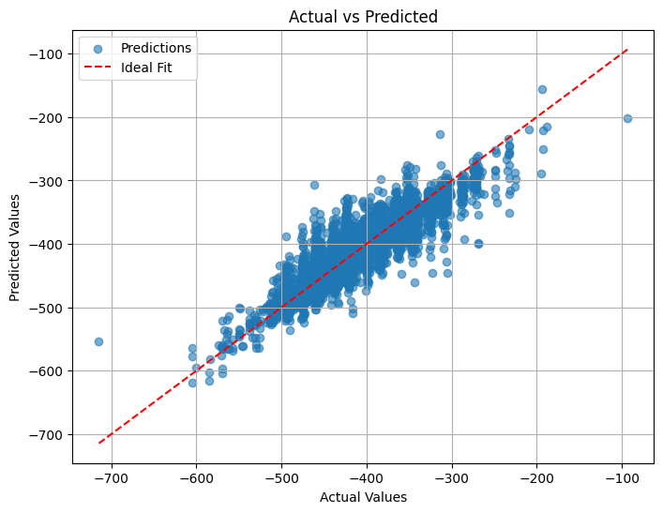
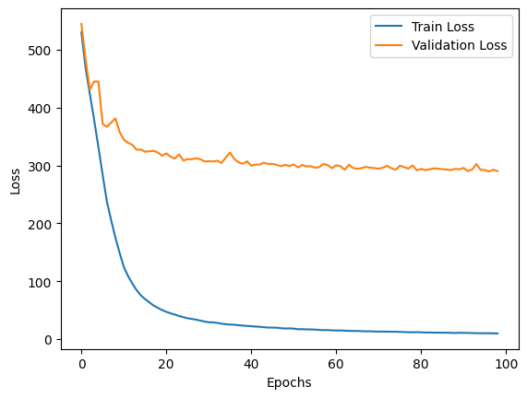
Results
Inference Time per 1000 samples: 0.7852 seconds
Mean Squared Error (MSE): 287.5763
Mean Absolute Error (MAE): 11.9760
R-Squared (R²): 0.8199

Slide 5
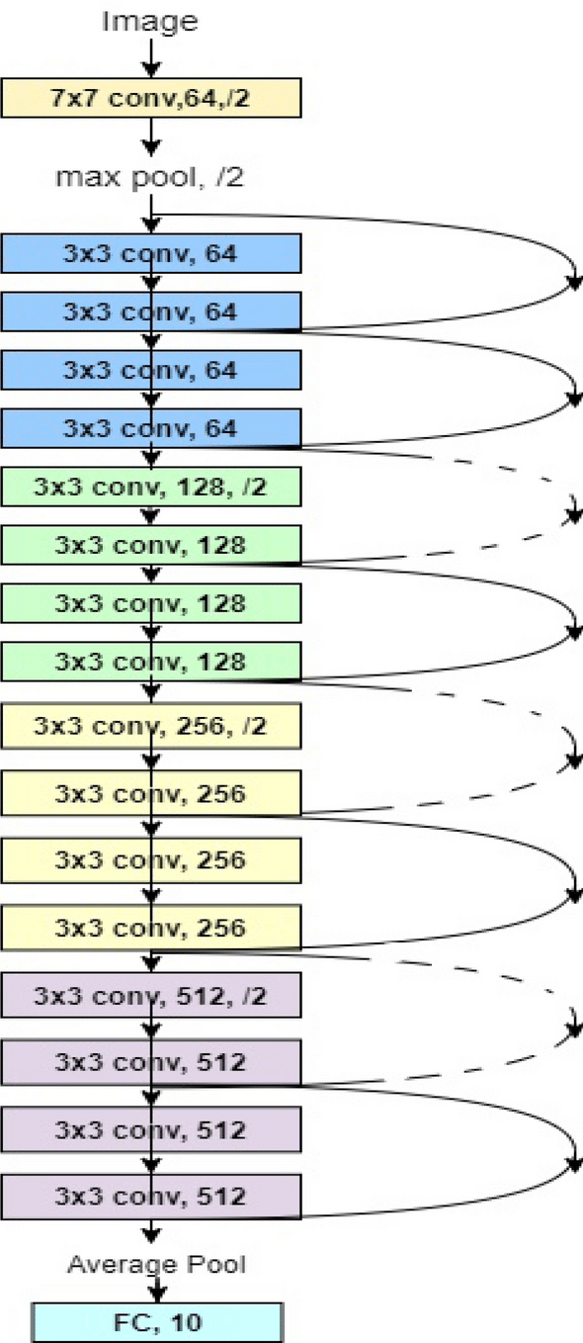
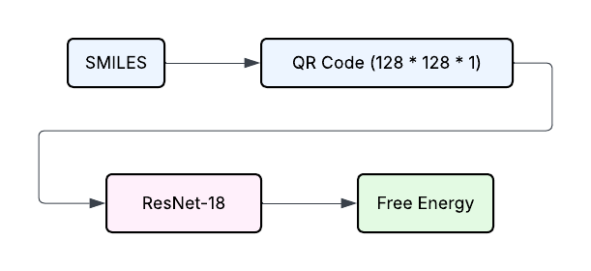
Quick Response Code – ResNet-18

Slide 6
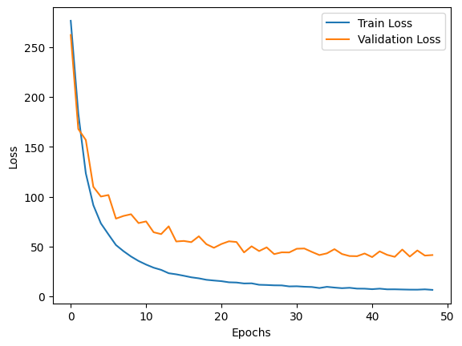
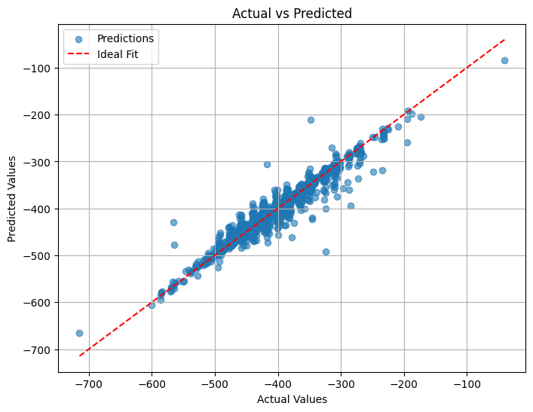
Results
Inference Time per 1000 samples: 10.5091 seconds
Mean Squared Error (MSE): 49.9385
Mean Absolute Error (MAE): 3.4024
R-Squared (R²): 0.9692

Slide 7
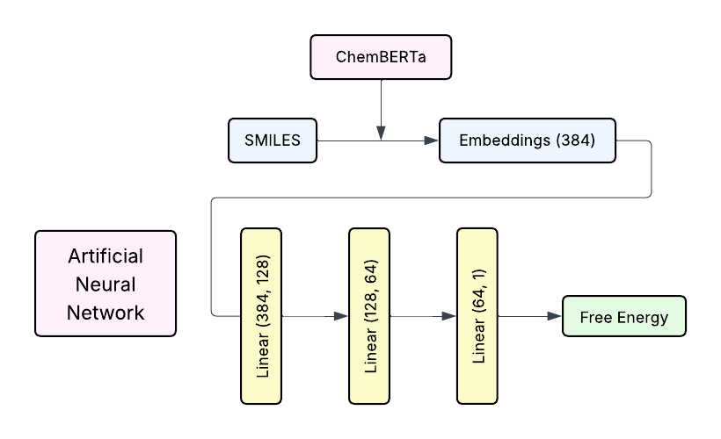
ChemBERTa Embeddings – ANN

Slide 8
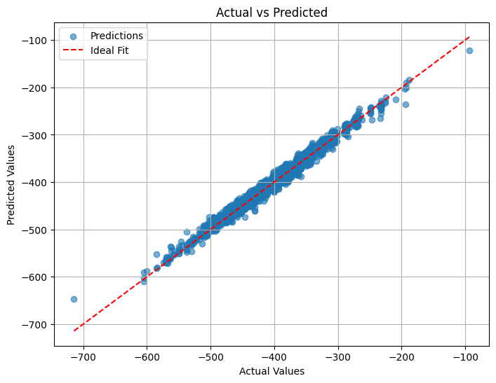
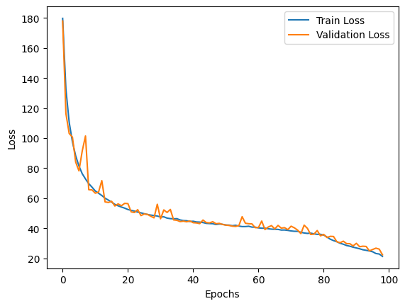
Results
Inference Time per 1000 samples: 0.6400 seconds
Mean Squared Error (MSE): 22.6927
Mean Absolute Error (MAE): 3.4568
R-Squared (R²): 0.9858

Slide 9
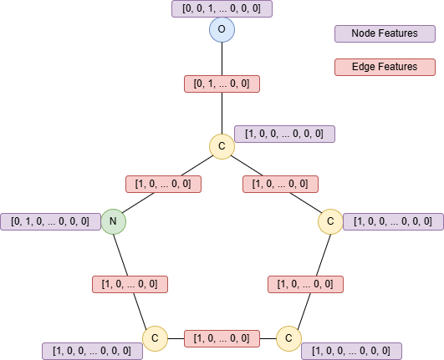
Graph Neural Networks – Data Featurization
Graph representation of 2-Pyrrolidinone (SMILES: C1CCNC1=0)

Slide 10
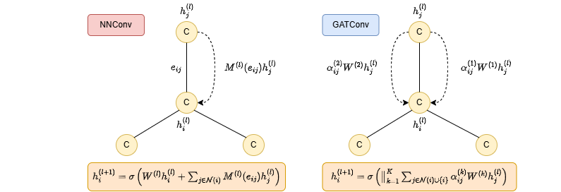
Message Passing

Slide 11
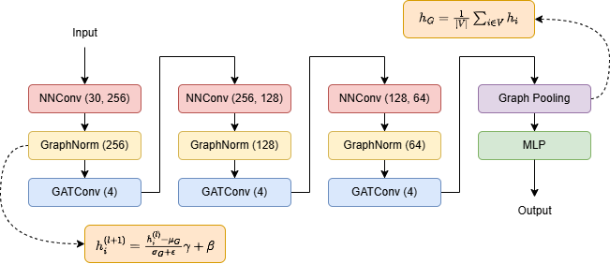
Model Architecture

Slide 12
Architectural Variations
Layer Configurations:
Two-layer architecture with node feature dimensions: 128 → 64.
Three-layer architecture with node feature dimensions: 256 → 128 → 64.
Attention Mechanism:
Models are trained with and without attention.
Attention-based architectures include 1, 2, or 4 attention heads.

Slide 13
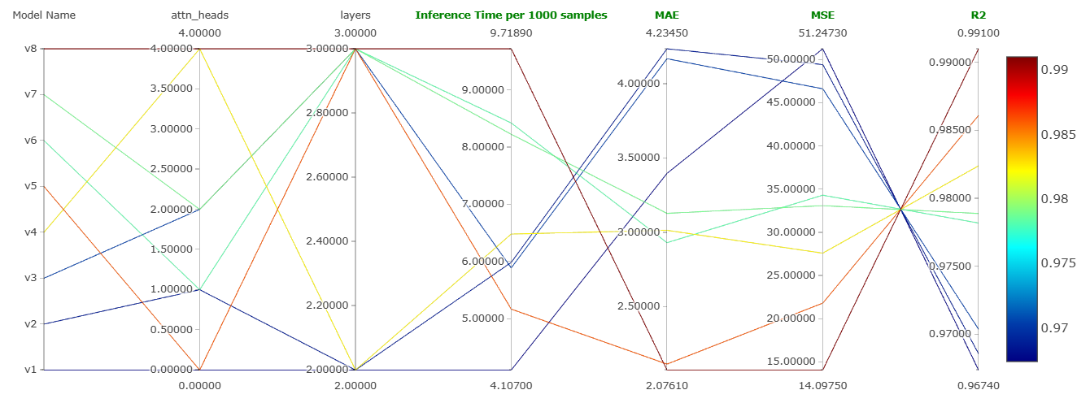
Results

Slide 14
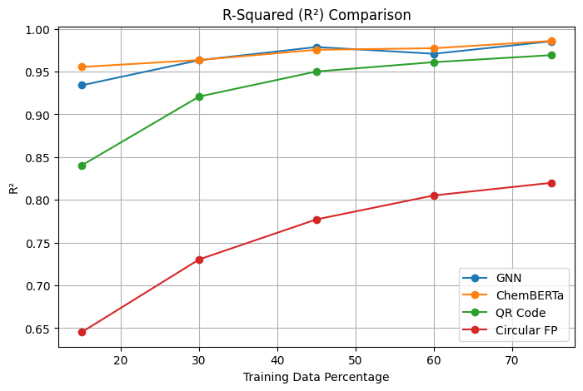
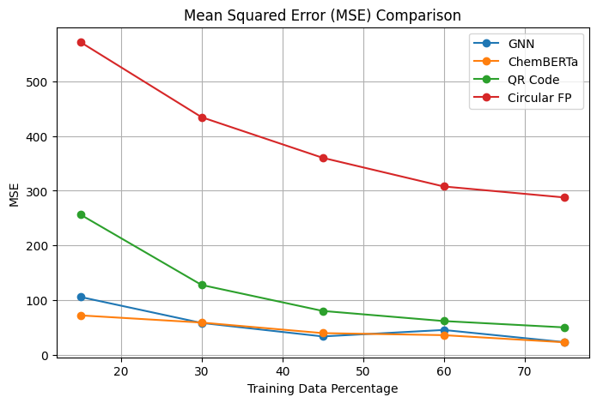
Comparison Plots
GNN – 3 Layered with 4 Attention Heads

Slide 15
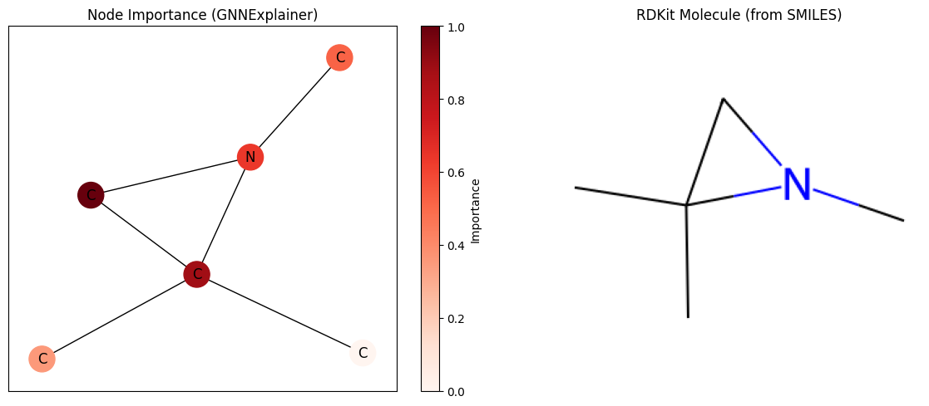
GNN Explainability
x_{i}^{masked} = node_mask(i) * x_{i} (Node Masking)
Loss = Prediction Loss + λ * Sparsity Regularization

Slide 16
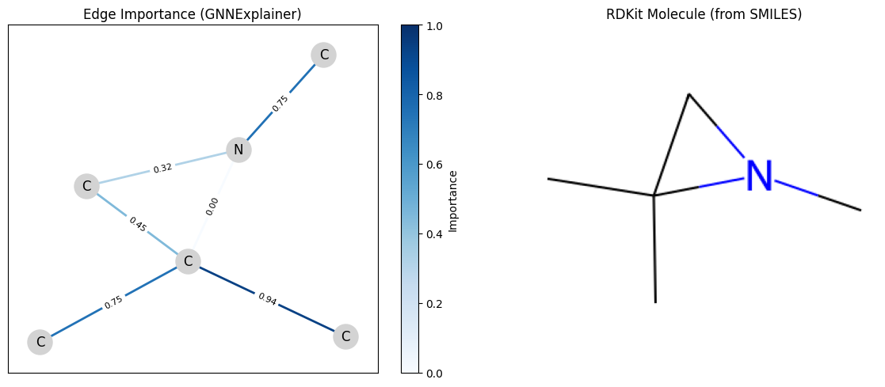
GNN Explainability
e_{i→j}^{masked} = edge_mask(i, j) * e_{i→j} (Edge Masking)

Slide 17
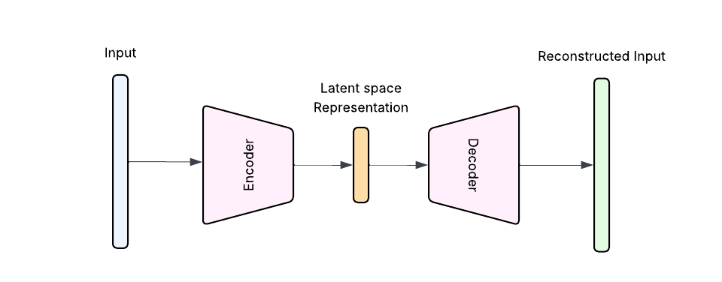
Autoencoders
Encoder: Maps input x to a latent vector z
Decoder: Reconstructs x′ from z
Loss: Reconstruction loss
Key Characteristics:
Deterministic: Given an input x, always outputs the same z
No assumption on the distribution of latent space

Slide 18
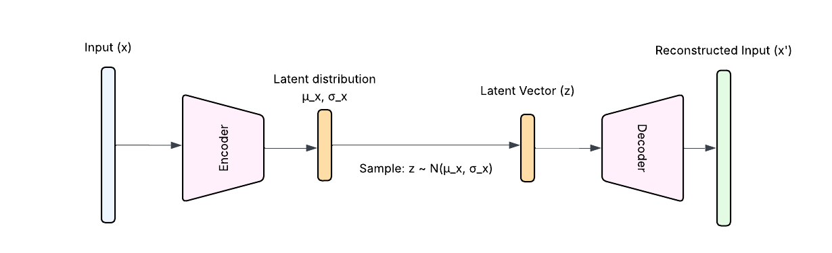
Variational Autoencoders (VAEs) & Conditional VAEs
Encoder: Learns parameters of a probability distribution q(z ∣ x), typically a Gaussian (mean μ and std σ) Sampling: Latent vector z is sampled from this distribution
Decoder: Reconstructs x′ from z
Loss: Reconstruction loss (like AE) & KL divergence between q(z ∣ x) and a prior p(z) (typically standard normal)
Key Characteristics:
Stochastic: Encoder outputs a distribution, allowing sampling
Latent space is continuous and regularized

Slide 19
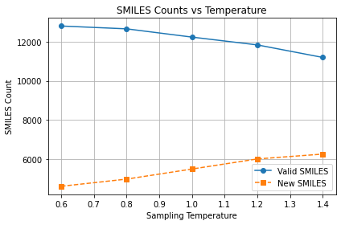
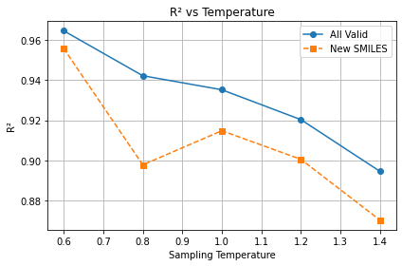
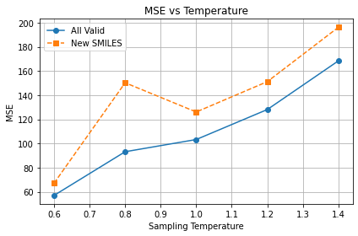
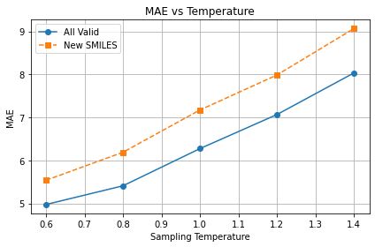
Results - Temperature Sweep (90% Training Data)

Slide 20
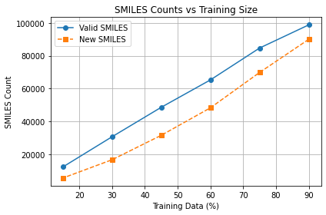
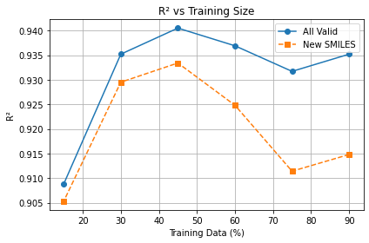
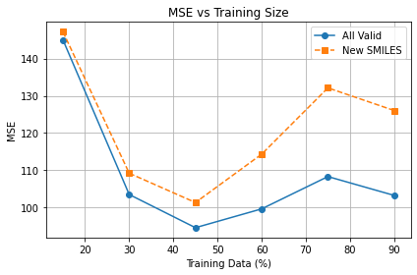
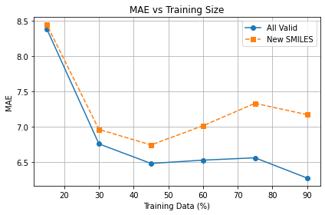
Results - Training Size Sweep (Temperature = 1.0)

